Slide 1
Facilitation Patterns
Antipatterns
This work is licensed under the
Creative Commons Attribution-ShareAlike 4.0 International License.
To view a copy of this license, visit http://creativecommons.org/licenses/by-sa/4.0/.

Slide 2
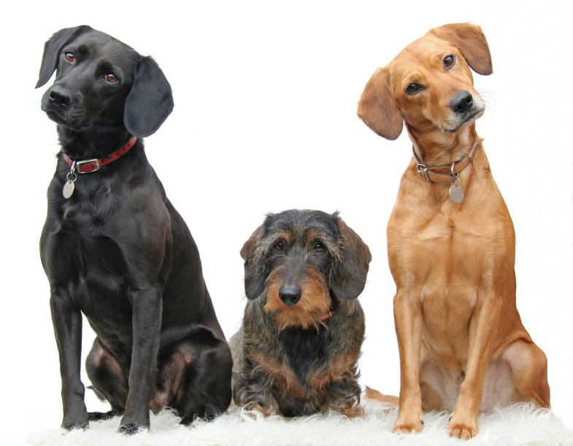
Notes:
Two Questions:
Who cares?
Who facilitates?

Slide 3

Notes:
One Answer: You Do!

Slide 4
"Group facilitation is a process in which a person whose selection is acceptable to all the members of the group, who is substantively neutral, and who has no substantive decision-making authority diagnoses and intervenes to help a group improve how it identifies and solves problems and makes decisions to increase the group's effectiveness.”
The Skilled Facilitator by Roger Schwarz
Notes:
Let them read this.

Slide 5
Facilitation is…
Notes:
"Group facilitation is a process in which a person whose selection is acceptable to all the members of the group, who is substantively neutral, and who has no substantive decision-making authority diagnoses and intervenes to help a group improve how it identifies and solves problems and makes decisions to increase the group's effectiveness.” --The Skilled Facilitator by Roger Schwarz [3]

Slide 6
Process
.
.
.
Notes:
"Group facilitation is a process in which a person whose selection is acceptable to all the members of the group, who is substantively neutral, and who has no substantive decision-making authority diagnoses and intervenes to help a group improve how it identifies and solves problems and makes decisions to increase the group's effectiveness.” --The Skilled Facilitator by Roger Schwarz [3]

Slide 7
Neutral
Notes:
"Group facilitation is a process in which a person whose selection is acceptable to all the members of the group, who is substantively neutral, and who has no substantive decision-making authority diagnoses and intervenes to help a group improve how it identifies and solves problems and makes decisions to increase the group's effectiveness.” --The Skilled Facilitator by Roger Schwarz [3]

Slide 8
No Authority
Notes:
"Group facilitation is a process in which a person whose selection is acceptable to all the members of the group, who is substantively neutral, and who has no substantive decision-making authority diagnoses and intervenes to help a group improve how it identifies and solves problems and makes decisions to increase the group's effectiveness.” --The Skilled Facilitator by Roger Schwarz [3]

Slide 9
Decisions
Notes:
"Group facilitation is a process in which a person whose selection is acceptable to all the members of the group, who is substantively neutral, and who has no substantive decision-making authority diagnoses and intervenes to help a group improve how it identifies and solves problems and makes decisions to increase the group's effectiveness.” --The Skilled Facilitator by Roger Schwarz [3]

Slide 10
Antipatterns
Patterns
Notes:
Patterns
Working with Martin Fowler, I felt like I had to address this in patterns and antipatterns ;)
Patterns: Attitudes, behaviors, and characteristics that lead to more effective meetings and, therefore, more valuable results. And maybe, just maybe, the meetings will be more enjoyable.
Antipatterns
Anti-pattern definition on Wikipedia: Some repeated pattern of action, process or structure that initially appears to be beneficial, but ultimately produces more bad consequences than beneficial results,
Both apply to Facilitator and Participants

Slide 11
Neutral
Notes:
Motto: It’s not up to me.
Belief: Neutrality prevents conflict.
Behavior: Rarely expresses opinions or takes a position. Facilitative.
Characteristics: Passive collaborative, facilitative.

Slide 12
Guide
Notes:
Motto: I'm here to hold the lamp and show the way.
Belief: My role is to help you find your way and shine the light where it's needed.
Behavior: Listens, asks, reframes and rephrases.
Characteristics: Calm, attentive, patient, and offering.

Slide 13
Curious
George
Notes:
Motto: I’m here to ask, not tell.
Belief: Asking questions is better than making statements.
Behavior: Asks questions, listens actively, and uses effective techniques to clarify and to elicit.
Characteristics: Calm, questioning, persistent
While a facilitator might be an expert in the domain under discussion, or expert in some related domain, the facilitator resists the urge to make statements/assertions/pronouncements. Rather, the facilitator is a master of questioning, bringing out information and encouraging participants to work together.

Slide 14
Sherlock Holmes
Notes:
Motto: With enough information, we can reach a conclusion.
Belief: It’s facts that count, not opinions, bound with reason.
Behavior: Asks questions, engages participants in inquiry, and guides them to reaching conclusions based on facts/information in evidence.
Characteristics: Patient, inquisitive, articulate
A brilliant London-based "consulting detective", Holmes is famous for his intellectual prowess, and is renowned for his skillful use of "deductive reasoning" while using abductive reasoning (inference to the best explanation) and astute observation to solve difficult cases. See Conclusion Jumper.

Slide 15
Benevolent Dictator
Notes:
Motto: I know what's best.
Belief: I have more knowledge/experience/wisdom than the rest of you, so you should listen to me, and I'll make sure you get to the right place. If you were competent, you probably wouldn't need me.
Behavior: Can be condescending, in a nice way – paternalistic.
Characteristics: pleasant, but insistent, in directing, driving, and choosing for others
The Benevolent Dictator is convinced of both his own benevolence and his own authority. That authority usually comes from his own belief, as opposed to any mandate or charter from the group or from above.
Story: MCA program, Miha

Slide 16
Repetitor
Repetitor
Repetitor
Notes:
Motto: It’s worth repeating. It’s worth repeating. It’s worth repeating.
Belief: You’ll only understand if I say it at least 3 times.
Behavior: Says the same thing repeatedly, frequently in somewhat different words, frequently 2 or 3 more times.
Characteristics: Articulate, filled with conviction, perhaps lacking confidence, perhaps not sure how to handle silence

Slide 17
Professor Moriarty
(the Evil
Genius)
Notes:
Motto: The end, if it’s what I want, justifies any means.
Belief: I can, and will, utilize any tool or stratagem to achieve my goals. I’m entitled to do so because I’m smarter and cleverer and it’s what I want.
Behavior: Manipulates, uses loaded language, conspires, convinces, distracts, distorts
Characteristics: Insidious, manipulative, conspiratorial, superficially open and honest This may be one of my least favorite antipatterns, because it’s so destructive, while trying to wear the guise of constructive and collaborative. The Evil Genius is the one who’s whispering to others, who catches others alone during breaks, who speaks against one to another, who proposes antagonistic ideas and tries to make them sound constructive, and so on.
It does go on and on.
It’s frequently hard to spot the Evil Genius, because they mask their insidious manipulation so well.
And their manipulations are destructive, because they violate all the principles of collaboration.
“If I can get this one to side with me against that one, then I’ll weaken the entire group so that I can achieve my ends.”
And they frequently delude themselves into thinking that they are working for the good of the group.
Frankly, I have trouble imagining someone acting in this antipattern as a facilitator. And if they were, I can’t imagine that they’d be open and honest enough to own up to it and change.
This one is hard to deal with, because they are so good at being deceitful and duplicitous.
Story: Bret

Slide 18
Gladiator
Notes:
Motto: It’s all about the combat!
Belief: The best results come from heated discussion/argument.
Behavior: Challenging and confrontational.
Characteristics: Doesn’t take it personally, and doesn’t understand why you do.
There are some people who seem to be happiest when they are immersed in conflict of various sorts. “Violent agreement” is frequently heard, along with being told that it’s more interesting that way, or that you shouldn’t have to hold back, or that it’s not personal, or…
The problem is that most people do not respond positively to being attacked, assaulted, dominated, overwhelmed with perceived verbal and physical violence. They frequently do take it personally.
As a facilitator, behaving this way is right up there with the Evil Genius - you just shouldn’t be facilitating, unless it’s the Ultimate Fighting Championships!
As a participant, you contribute to creating a situation in which no one else is interested in speaking up. Why speak up when someone is going to challenge you to a fight? That’s not fun for most people.
Dealing with The Gladiator requires the patience and confidence to talk to them directly and ask them to tone it down. In many cases, Gladiators are not actually bad people - they’ve just fallen into a pattern of behavior that has worked for them.
Story: Scott & Bret

Slide 19
Superhero
Notes:
Motto: I'm here to rescue you.
Belief: I bring special skills and knowledge, and you must want me to use them.
Behavior: Leaps into the breach to answer questions, solve problems, soothe injured feelings, and otherwise care for the participants.
Characteristics: Gentle but firm, frequently offering answers/solutions rather than asking questions.
The Superhero operates from the conviction that she is here to save the group, to apply her special powers and knowledge to make sure that everything comes out right. While this can be benevolent, it frequently disempowers the group.

Slide 20
Orator
Notes:
Motto: I’m worth listening to.
Belief: I know that people love to hear what I have to say because I’m so articulate and I have such a way with words.
Behavior: Dominates the conversation by talking. And talking. And talking. Not malicious, just unable to hear anyone besides herself.
Characteristics: Relentless, verbose, determined.

Slide 21
Conclusion Jumper
Notes:
Motto: I don’t need to hear everything you have to say - I’ve got it!
Belief: I am quicker than others in figuring things out, and am required to tell them so.
Behavior: States a conclusion as if they have enough information, then argues the point.
Characteristics: articulate, convincing
In my life, I have been so guilty of this. When I was younger, because I knew I was smart, I always assumed that I knew where the other person was going and would jump in. Of course, the other person was offended/annoyed, even if I was right.
Why? Because they wanted to finish what they had to say. They didn’t care that I was impatient to move on, that I thought I knew what they were going to say and where they were going, that I thought I was smart - they wanted a show of respect.
Yup - Conclusion Jumpers are generally disrespectful. What their behavior says is “I’m smart, I’m fast, and what you have to say is less important than my desire to show my smarts and move things forward.” Who is that about? Them - the Jumper - not me.
If you are a facilitator, even if only for one meeting, then your responsibility is to be patient, listen, ask questions - not interrupt, nor assume that you know what someone means or what they’re going to say. Your responsibility is to encourage all parties to listen to all parties - if you don’t do it, then they will learn that they don’t have to.
In fact, part of your responsibility is to teach everyone present about respect and patience and listening.
I seem to have used the word responsibility a lot in this post, don’t I?

Slide 22
Time for some fun!
Get into groups of 8 – 10 people
Someone shuffle the cards (after pulling out the advertising ;-)
Deal one card to each person in your group
READ THIS CAREFULLY BEFORE YOU LOOK AT YOUR CARD
DO NOT REVEAL YOUR CARD, except…
If you receive the Facilitator card, you may reveal your card
Have a conversation for ~8 minutes, behaving according to your card
Spend 4 minutes guessing each other’s patterns

Slide 23
Group Discussion
Notes:
What did you learn? What was hard to detect? Was anyone a facilitator?

Slide 24
What to do when (or before) you run into these patterns

Slide 25
The Facilitation Four-Step
(Intervention)
Notes:
Interrupt
Ask
Redirect
Commit

Slide 26
1. Interrupt
Notes:
Excuse me…

Slide 27
2. Ask
Notes:
…do you mind if I…

Slide 28
3. Redirect
Notes:
…ask Joe what he thinks about this?

Slide 29
4. Commit
Notes:
I promise we’ll come back to you.

Slide 30
Safety Check
(Preventative)
Notes:
Check to make sure folks are comfortable to speak.
ESVP
Explorer
Shopper
Visitor
Prisoner

Slide 31
Ground Rules
(Preventive)
Notes:
Aka Working Agreements – setting things up in advance, social contract – treat each other with respect, no interrupting, etc.

Slide 32
Active Listening
(via the IAF Methods Database @
http://www.iaf-methods.org/node/5255)
(Intervention)
AMPP*
Ask
Mirror
Paraphrase
Prime
Notes:
International Association of Facilitators
Ask: how are you feeling about that? What do you think about that?
Mirror: when you believe someone is not being forthcoming about what’s really motivating/driving them
“You say you’re okay, but by the tone of your voice, you seem upset.”
“You seem angry to me.”
“You look nervous about confronting him. Are you sure you’re willing to do it?”
Paraphrase: when you want to clarify and break the flow
“Let’s see if I’ve got this right. What I understood you to say is…”
Prime: when no one is forthcoming
Are you thinking…?”

Slide 33
Role Reversal
(Intervention)
Notes:
Have people argue/present an opposing/different perspective or approach. It forces them to consider the other’s point of view, especially if they really get into it.
People will resist, or say things like “I can’t argue for that because I don’t believe it.” Get them to take it on as role play – encourage them to speak and act as the other person, trying to say what the other person would say. Be cautious of people who try to belittle the other by exaggerating in a negative way.

Slide 34
Starfish
(Preventive / Curative)

Slide 35
Keep Doing
Start Doing
Stop Doing
Do More Of
Do Less Of

Slide 36
Circle of Questions
(Preventive / Curative / Intervention)
Notes:
First person turns to person on their left, asks question. Second person answers – no one else speaks – then turns to the person on their left and asks a question. Continues around circle.

Slide 37
The Margolis Wheel
(Preventive / Curative / Intervention)
http://www.stevenlist.com/blog/2009/02/15/the-margolis-wheel
Notes:
http://www.stevenlist.com/blog/2009/02/15/the-margolis-wheel/
Robert Chambers is a research associate of the Institute of Development Studies at the University of Sussex, England. He is one of the world’s most influential proponents of participatory development. His other books include “Whose Reality Counts?”, and “Challenging the Professions.”

Slide 38
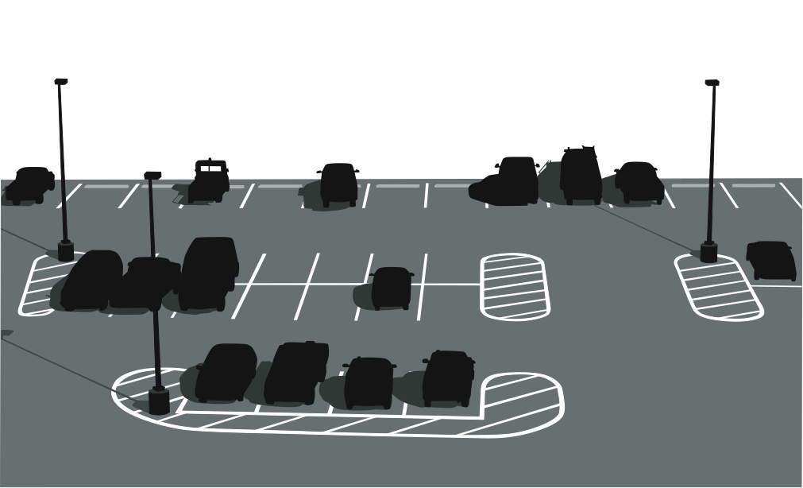
Parking Lot

Slide 39
Books and Resources
Collaboration Explained – Jean Tabaka (!)
Agile Retrospectives – Diana Larsen and Esther Derby (!)
Participatory Workshops – Robert Chambers
The Skilled Facilitator – Roger Schwarz
Facilitator's Guide to Participatory Decision-Making – Sam Kaner
Crucial Conversations – Kerry Patterson et al

Slide 40
Books and Resources
Facilitation Patterns from Jeremy Lightsmith
www.facilitationpatterns.org
International Association of Facilitators Methods Database
www.iaf-methods.org
Patrick Kua’s Blog
http://www.thekua.com/rant/2006/03/the-retrospective-starfish

